Slide 1
Project: Data Visualization and Dashboards with Tableau
Leonardo Fonseca
Sep 26th, 2023

Slide 2

Canada housing data

Slide 3

Introduction
Welcome to this presentation, where I will explore key insights into Canada's real estate market using Tableau. The project delves into several crucial questions, each addressing a unique Canadian real estate landscape facet.

Slide 4
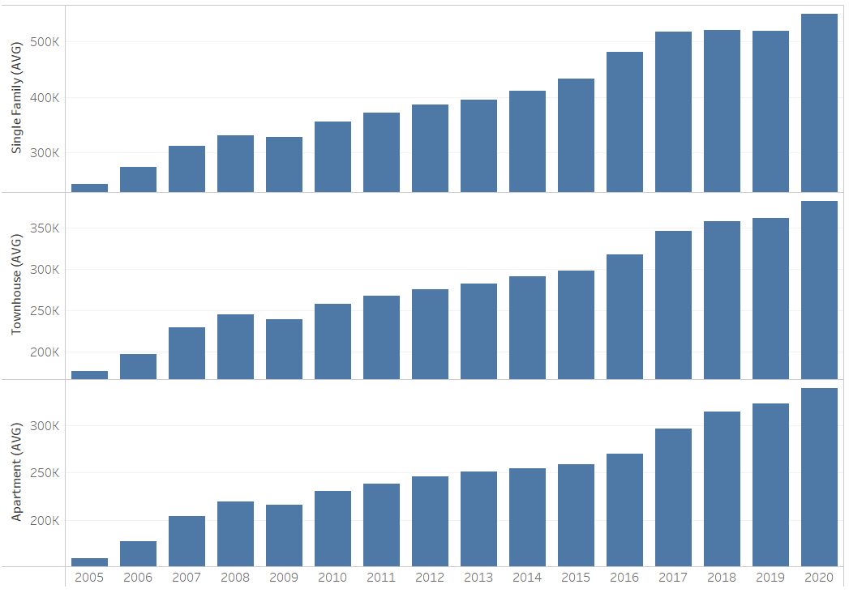
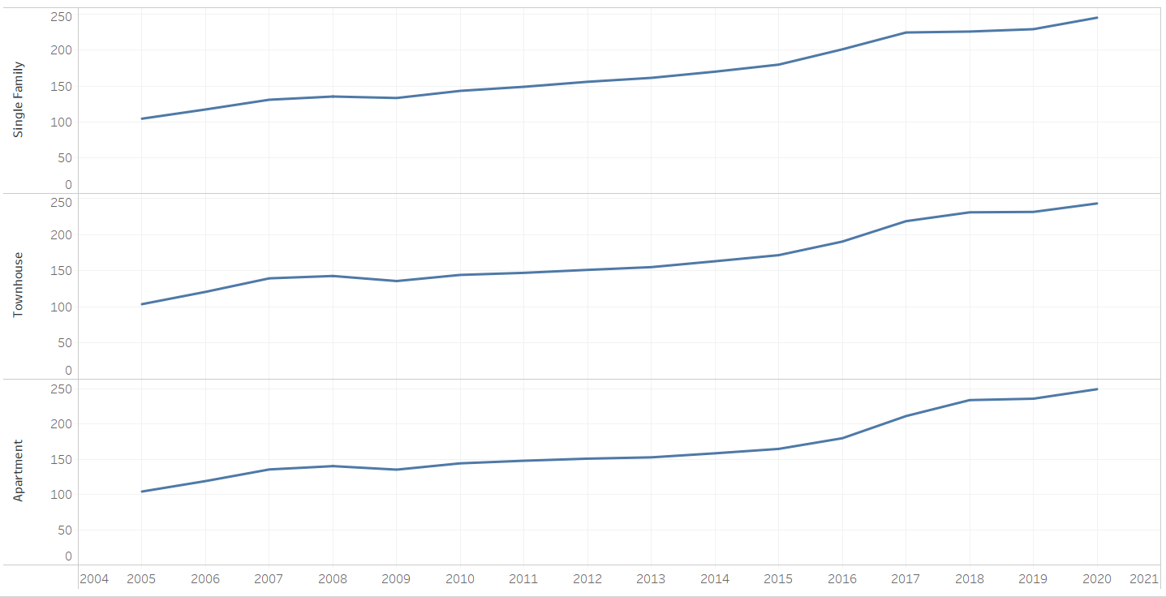
Trends in House Prices Across Canada

Slide 5
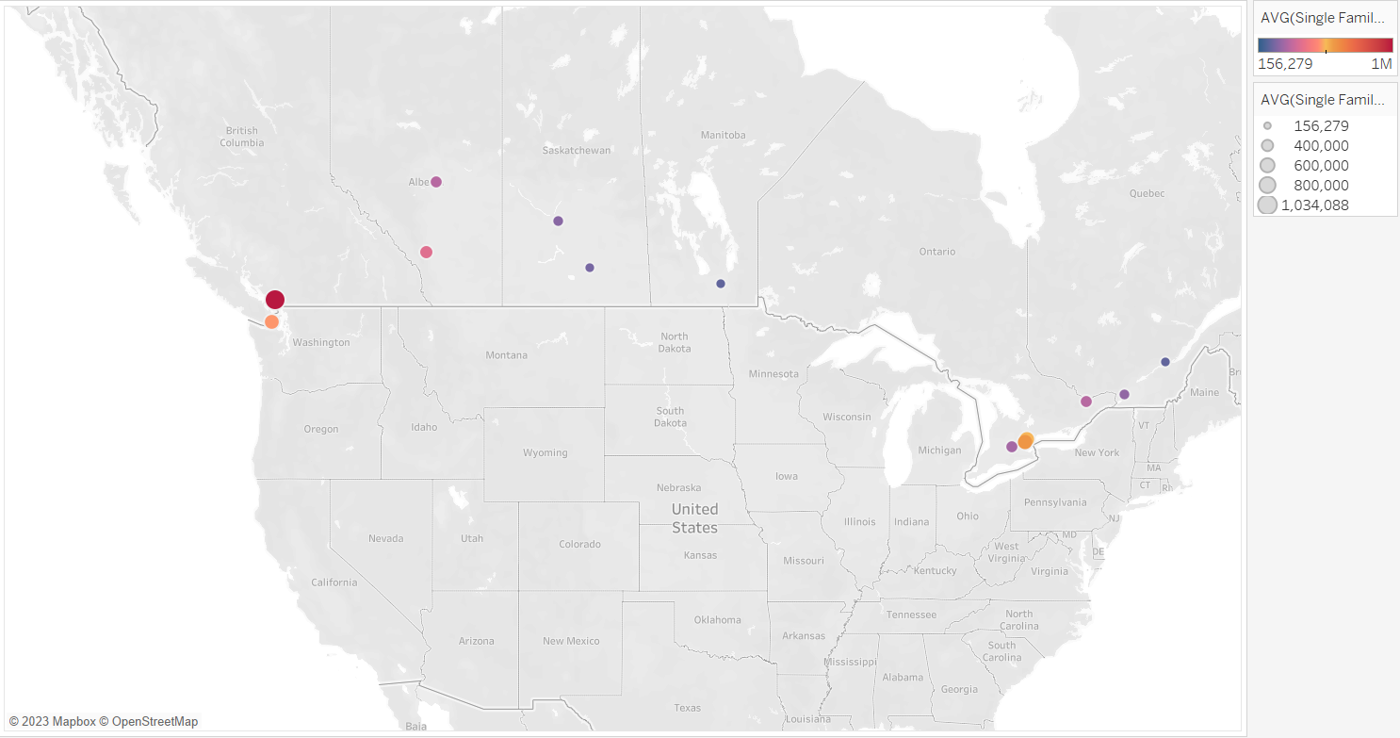

Slide 6
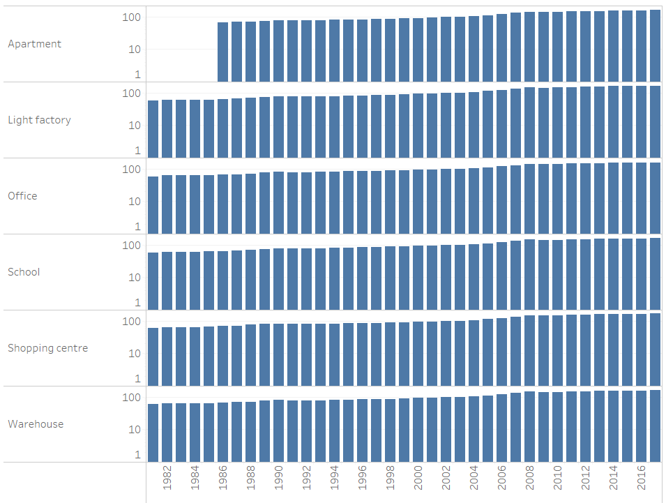
Offices

Slide 7
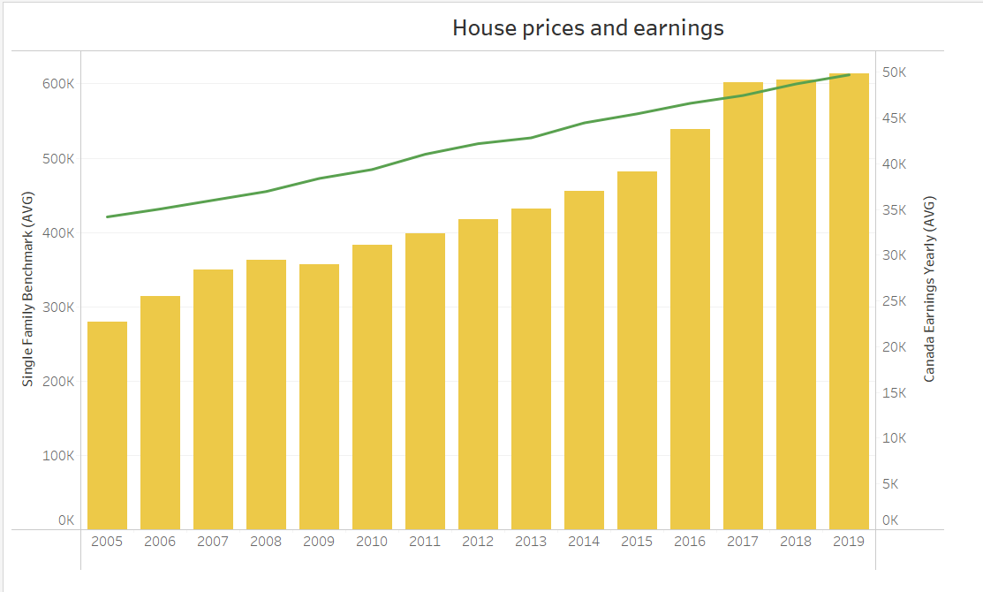
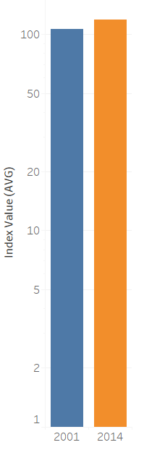
House prices and earnings
Did people spend more of their earnings in 2014 than they did in 2001?

Slide 8
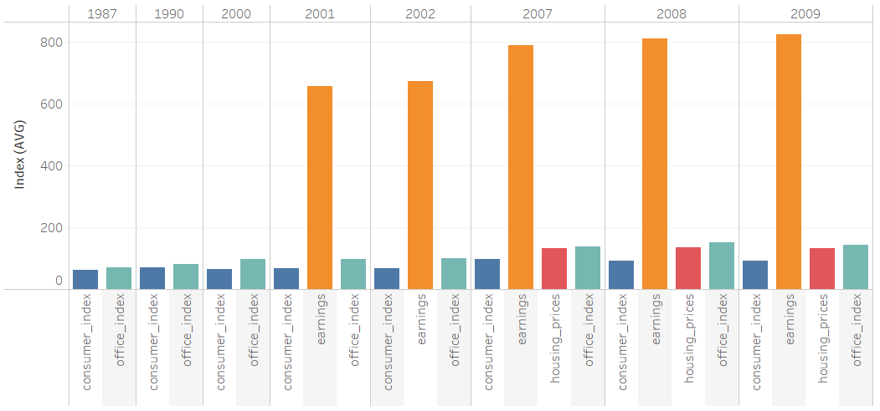
Impact of Economic Crises

Slide 9
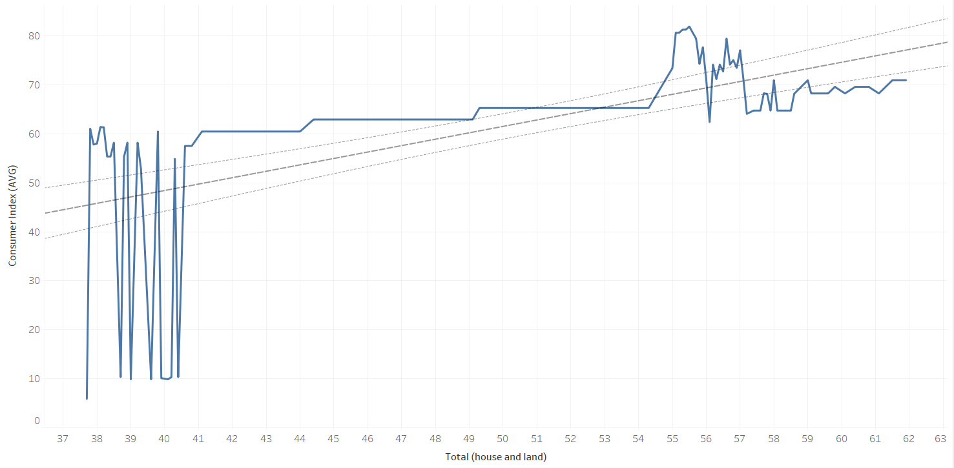
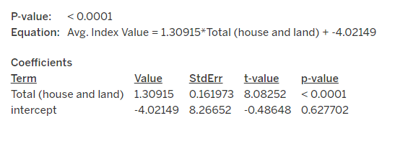
Predicting Consumer Index from Housing Price Index
Strong and highly significant relationship between Total (house and land) and Avg. Index Value.
A unit increase in Total(house and land) predicts an increase in Avg. Index Value.
Business insight:
This suggests that changes in real estate assets have a considerable impact on the consumer index value, an insight that can be incredibly valuable in the decision-making processes.

Slide 10



If I have more time...
Deeper Analysis of Economic Impact
Geospatial Analysis
Predictive Modeling
Market Segmentation
Sentiment Analysis
International Comparisons

Slide 11




Thank you

